Slide 1
Emotion Recognition
AKITI SRI KALYAN REDDY
19STUCHH010130

Slide 2

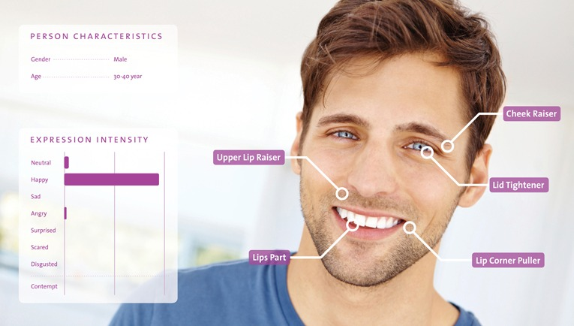
Introduction
In our daily lives, we encounter various situations and emotions. An emotion is a strong feeling about a human situation.These emotions and thoughts are expressed through facial expressions and for detecting those emotions we will be using Emotion recognition.It is a technique that uses advanced image processing to read the emotions on a human face where, it detect emotions of different format from the given data.

Slide 3
Application of emotion detection in real life:
retail: advertising/marketing
Health sector: hospitals and healthcare
Education: eye tracking to information of students
SenseCrowd: for doing experiments in physical environment
There are some companies that make use of emotion detection such a disney and Unilever

Slide 4
Why emotion detection
The motivated to work on this project to contribute to this field and enhance improvements in the application's and the huge investments large corporates do in feedbacks and surveys but fail to get equitable response on their investments.
Emotion detection through facial gestures is a technology that aims to improve product and services performance by monitoring customer behavior to certain product and services of staff by their evaluation

Slide 5
Approach of Facial Emotion Detection Using CNN
Dataset
Image Augmentation
Feature Extraction
Training
Validation

Slide 6
Facial Emotion Detection
In this research, we describe a dilated convolution-based approach to learning about convolutional neural networks. Where we'll build a deep network to identify facial emotions
collect the data that has been broken down into various classes and label it in a sequential manner and use it for building a model.

Slide 7
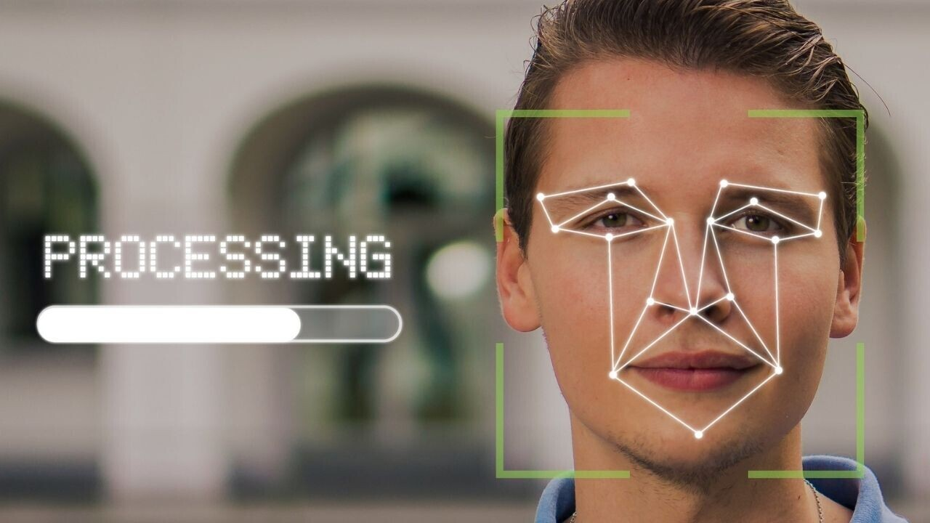
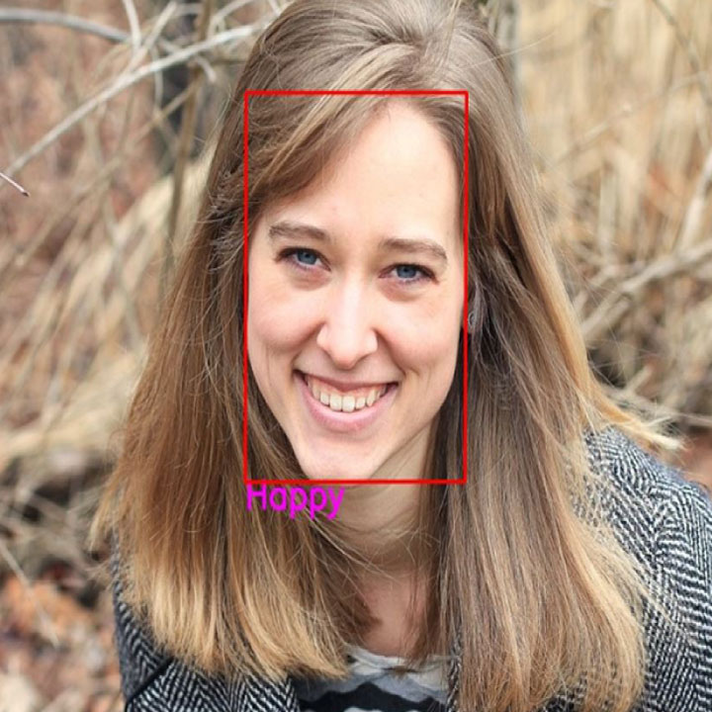
There are numerous emotions that a human can experience in facial emotion detection. Therefore, we will concentrate on a few courses and train a model that can detect face emotion.
The machine learning model will then attempt to differentiate between various inputs before producing results.
It will use facial recognition to find human faces and artificial intelligence techniques like neural networks to analyse human emotions.

Slide 8
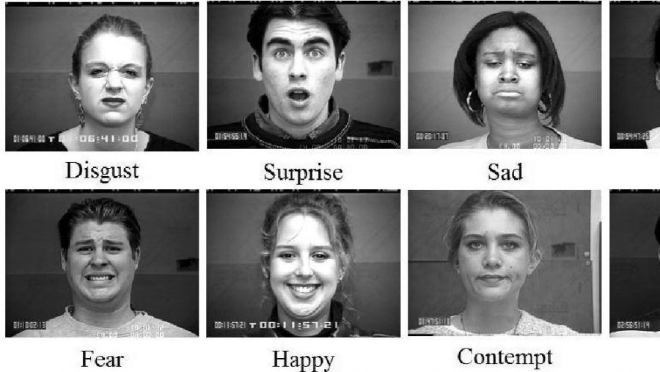
Dataset Description
People display a variety of emotions, anger,sadness, disgust, fear, happiness, and surprise. By utilising all these qualities, we may achieve advancements in a number of different areas.
The data consists of 48X48 pixel grayscale images of
Images of faces.The faces have been classified into
Seven categories(0=Angry,1=Disgust,2=Fear,3=Happy,
4=Sad,5=Surprise,6=Neutral)
The training set consist of 28,703 examples.The public
set used for leaderboard of 3,589 examples. The finial
set, to evaluate the model,consists another 3,589
examples. This data was prepared by FER-2013 on going
research project.

Slide 9
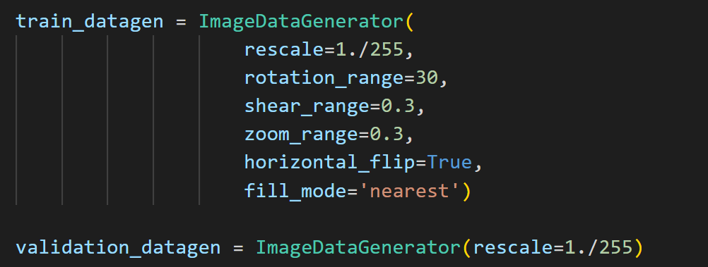
Image augmentation
More data is generated using the training set by applying transformations.
It is required if the training data is not sufficient enough to learn representation.
The Image data is generated by transforming the actual training images by rotating,crop,shift,sher,zoom,flip,reflection,normalization etc.

Slide 10
CNN-conventional neural network
A CNN architecture is typically divided into three components:
Convolutional layer
Pooling Layer
Fully connected Layer
In a process known as Feature Extraction, a convolution tool isolates and identifies the distinct characteristics of an image for analysis.
A fully connected layer that uses the output of the convolution process to forecast the image's class using the information acquired in previous stages.

Slide 11
Layers and Optimizer
● Convolutional Layer
This is the initial layer that extracts the different features from the input photos. The convolution mathematical process is done between the input image and a filter of a specific size MxM in this layer. The dot product between the filter and the sections of the input image with regard to the size of the filter is taken by sliding the filter across the input image (MxM)
● Pooling Layer
A Pooling Layer is usually applied after a Convolutional Layer. This layer's major goal is to lower the size of the convolved feature map in order to reduce computational expenses. This is accomplished by reducing the connections between layers and operating independently on each feature map. There are numerous sorts of Pooling operations, depending on the mechanism used.
● Fully Connected Layer
The Fully Connected (FC) layer connects the neurons between two separate layers by combining the weights and biases with the neurons. The last several layers of a CNN Architecture are usually positioned before the output layer.

Slide 12
● Dropout
When all of the characteristics are connected to the FC layer, the training dataset is prone to overfitting. Overfitting happens when a model performs so well on training data that it has a negative impact on its performance when applied to new data.
● Activation Functions
Finally, the activation function is one of the most crucial elements in the CNN model. They are used to learn and approximate any continuous or complex relationship between network variables. In simple terms, it determines which model information should fire in the forward direction and which should not at the network's end.
● GlobalAveragePooling2D
Tensorflow.js is an open-source toolkit created by Google for running deep learning neural networks and machine learning models in the browser or on the node platform[47]. Additionally, it enables programmers to build machine learning models in JavaScript and use them with Node.js or directly in the browser. The global average pooling procedure for geographic data is applied using the tf.layers.globalAveragePooling2d() function.
● Flatten layer
The input's spatial dimensions are condensed by a flatten layer into its channel dimension[48]. When your project is complete and you want to make all of your layers into a background image since you no longer want to change them, Flatten Image is advised. In this manner, you can export the final image and utilize it however you like.

Slide 13
● MaxPooling2D
2DMaximum pooling for 2D spatial data.The input is downsampled along its spatial dimensions (height and width) by taking the maximum value for each input channel over an input window with a size determined by pool size[49]. Each dimension of the window is moved one step at a time.
OPTIMIZER
These are algorithms or methods used to minimize an error function(loss function)or to maximize the efficiency of production. Optimizers are mathematical functions which are dependent on model’s learnable parameters i.e Weights & Biases. Optimizers help to know how to change weights and learning rate of neural network to reduce the losses.
For model compilation the optimizer used is Adam and loss is equal to categorical cross entropy with metrics as accuracy.

Slide 14
Validation
In validation phase, various OpenCV functions and keras functions have been used.
Initially, Image is stored in Image object and same goes with video.
Image frame is converted into grayscale and resize and reshaped with the help of numpy.
The resized argument is fed to predictor which is loaded by Keras.models.load_model() function.
The max argument is output.
A rectangular box is drawn around the face and label is formatted above the rectangular box

Slide 15
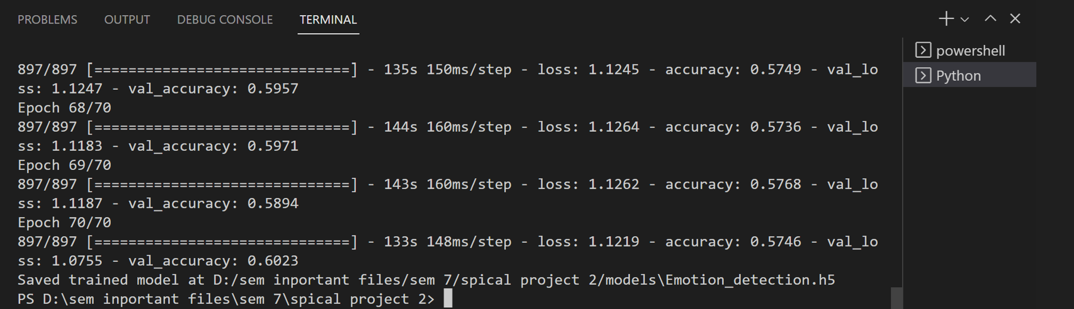
Performance evaluation
This is a complex subject that has been handled multiple times using various strategies. While this experiment concentrated on keras and CNN yielded positive outcomes. This project achieves the desired output, which is that it detects a face from a given input within a border and detects the emotion of the face, displaying the detected output as happy, sad, neutral, angry, and surprised with a 60.23% accuracy.

Slide 16
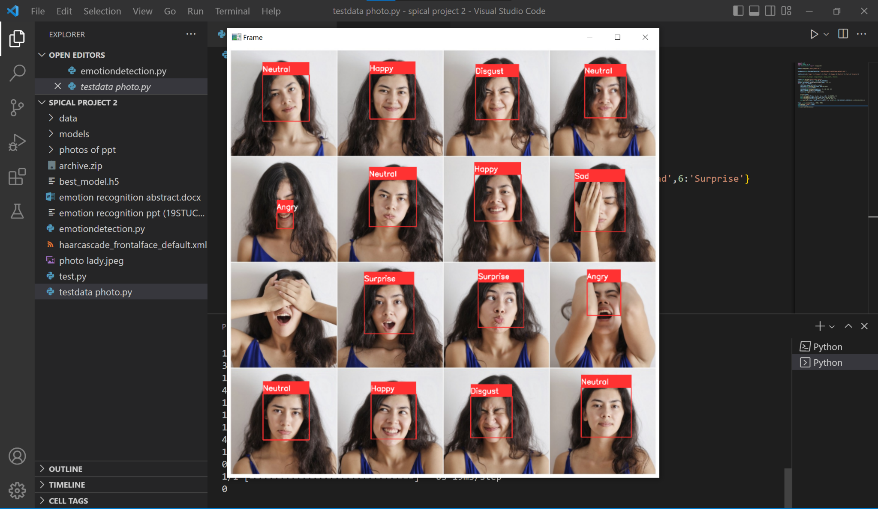
Image Output

Slide 17
THANK YOU

